Slide 1
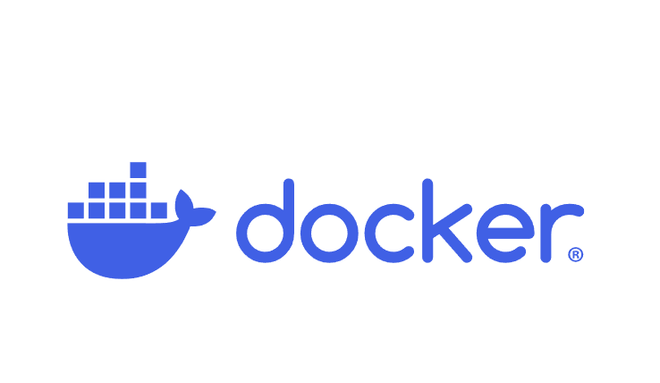

using docker Part 2: setting up jupyter lab

Slide 2
What you will learn
Why use Jupyter Lab and Docker?
Data Science with Jupyter Lab
Pulling and Running the Jupyter Lab Image
Breaking Down the Initial Run
Making Changes

Slide 3
Why use Jupyter Lab and Docker?

Slide 4
Why use docker locally?
Docker avoids local clutter by encapsulating dependencies in containers, keeping your system clean.
If you misconfigure something, you can easily reset the environment by rebuilding containers.
Docker images can be versioned, allowing you to switch between or revert to known working states.
Docker provides detailed logs and monitoring tools for easy local debugging.
Docker allows you to delete and recreate containers quickly without reinstalling dependencies.
You can safely experiment with different libraries, frameworks, or configurations by spinning up isolated containers.
If something breaks, you can delete the container and start fresh without affecting your system.
You can create different containers with various versions of dependencies to test different setups locally.

Slide 5
Why use docker for a team or enterprise?
Docker ensures consistent environments across the team, preventing configuration issues.
Docker simplifies sharing and managing development environments.
Docker isolates dependencies, avoiding conflicts between projects.
Docker streamlines CI/CD processes, ensuring consistency between development and production.
Docker enables fast onboarding and easy collaboration with pre-configured environments.
Docker enhances scalability and simplifies deployments for enterprise applications.
Docker allows teams to version infrastructure and easily roll back to previous setups.
Docker improves security through application isolation and reduces dependency risks.
Docker integrates with cloud services, making scaling and deployment easier.
Docker centralizes logging and monitoring for better team troubleshooting.

Slide 6
Data Science with Jupyter lab

Slide 7
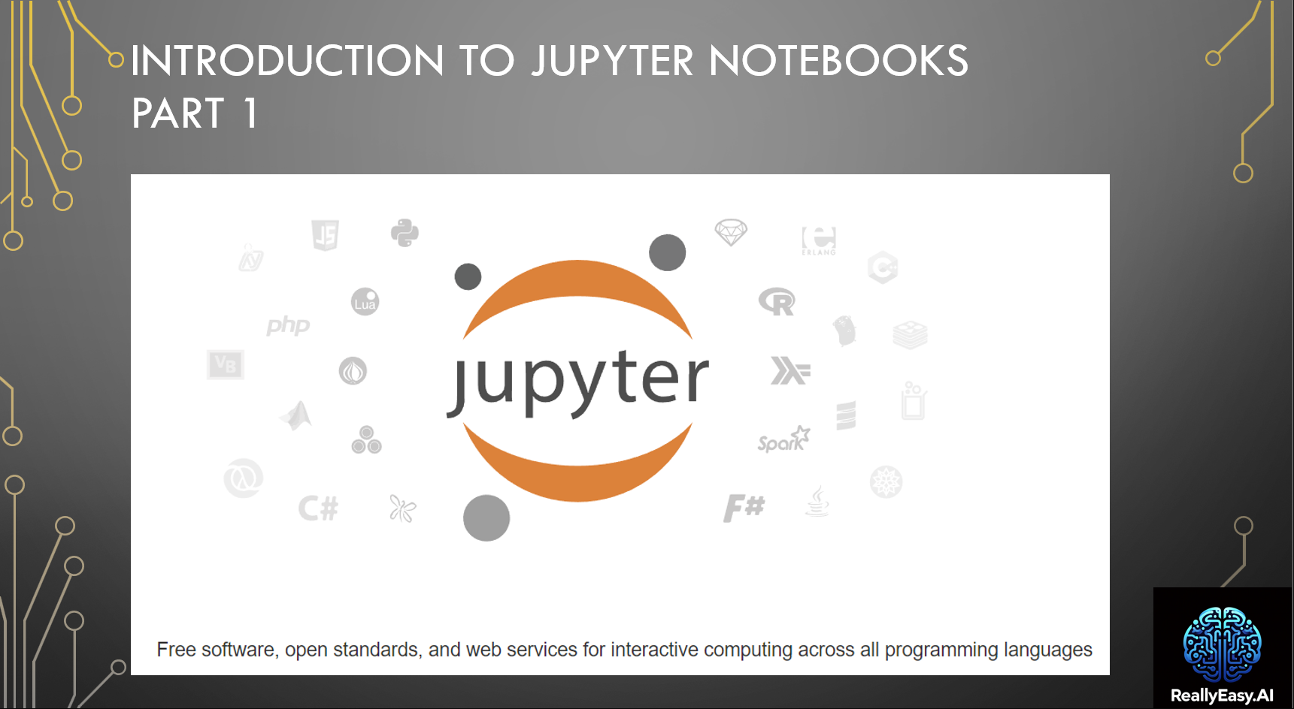
Notes:
Setting Up for Data Science Playlist
https://www.youtube.com/watch?v=50TM9pfYv5U&list=PL7hc7ZLdMi6rbt-x9pjg4PByKFZz3hx7Q

Slide 8
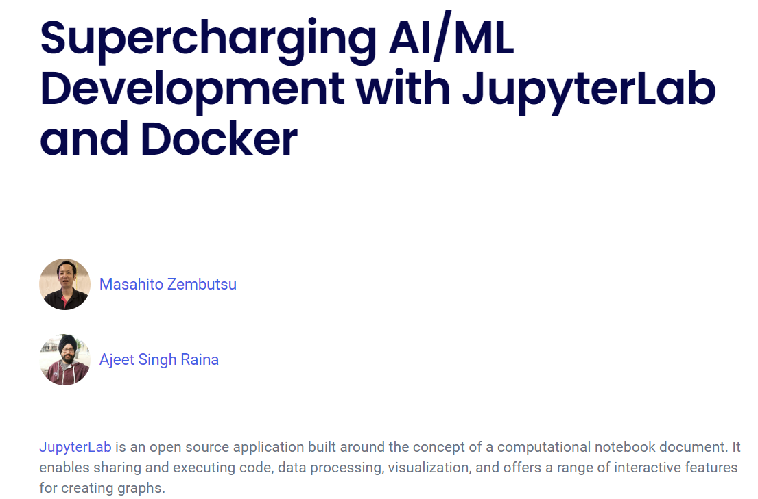
Notes:
https://www.docker.com/blog/supercharging-ai-ml-development-with-jupyterlab-and-docker/

Slide 9
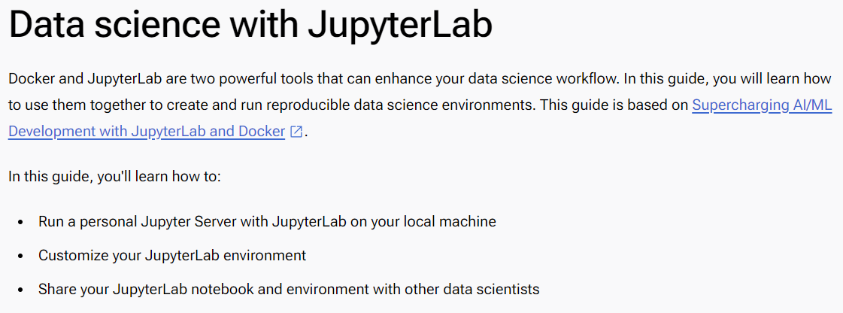
Notes:
https://docs.docker.com/guides/use-case/jupyter/

Slide 10
Pulling and Running the jupyter lab image

Slide 11
docker run --rm -p 8889:8888 quay.io/jupyter/base-notebook start-notebook.py
--NotebookApp.token='my-token'
Notes:
docker run --rm -p 8889:8888 quay.io/jupyter/base-notebook start-notebook.py --NotebookApp.token='my-token'

Slide 12
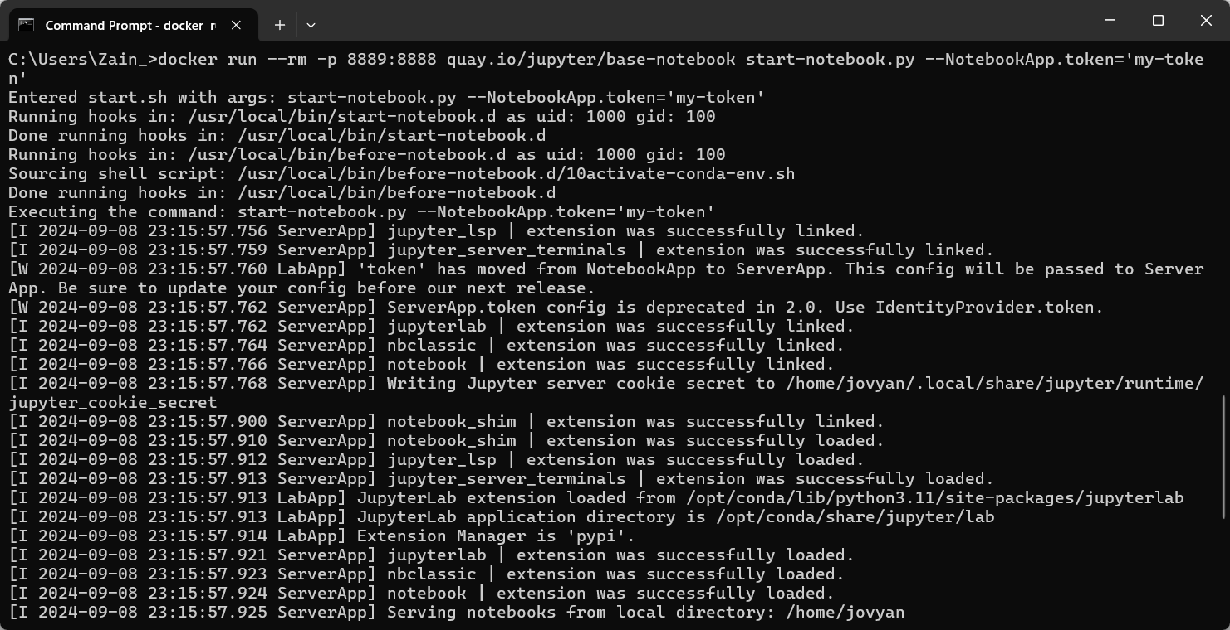
Demo: Running the Jupyter lab container

Slide 13

What happened?
New Container
5: Interact
1: Run
4: Deploy
Repository
Docker Engine
2: Pull
Pull Image
Create Container
3: Create

Slide 14
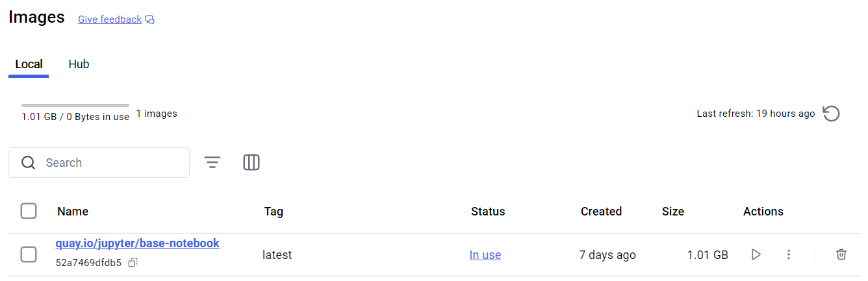
Docker Desktop view: image

Slide 15
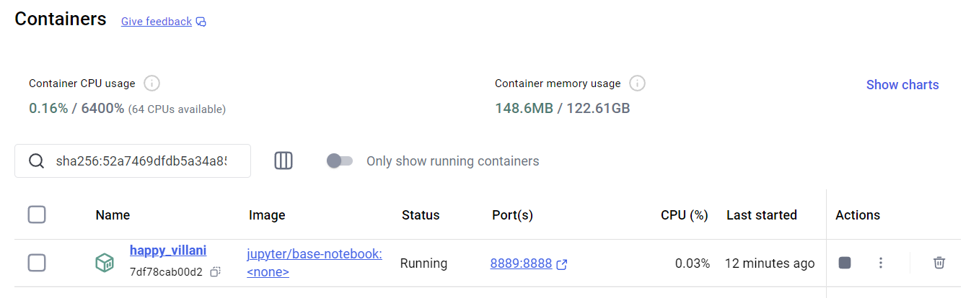
Docker Desktop view: Container

Slide 16
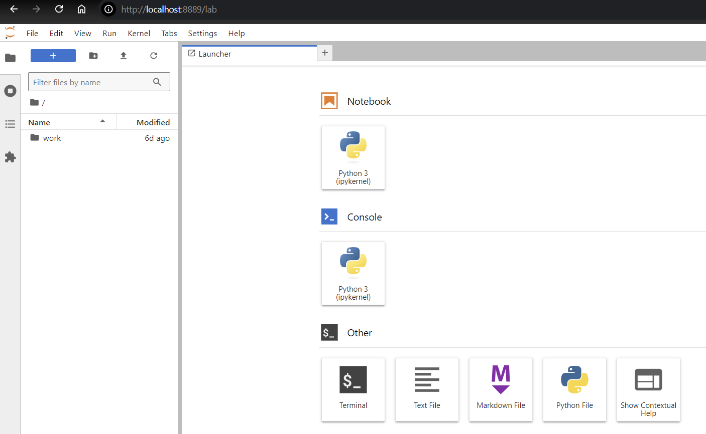
Demo: Connecting to the container

Slide 17
Breaking down the initial run

Slide 18
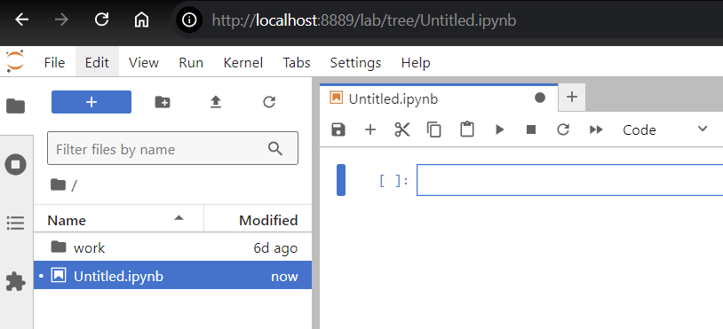
Demo: Creating a notebook and “Saving” it

Slide 19
Remove the container
docker run --rm -p 8889:8888
Port assignment (Host:Container)

Slide 20
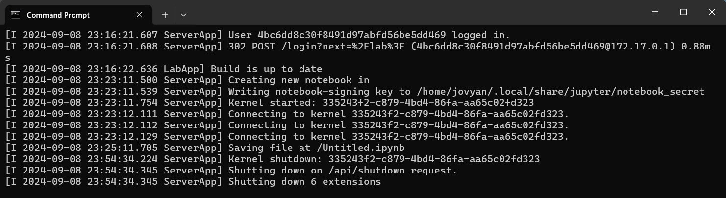
Demo: Stopping jupyter lab

Slide 21
Image repository
quay.io/jupyter/base-notebook
Image name

Slide 22
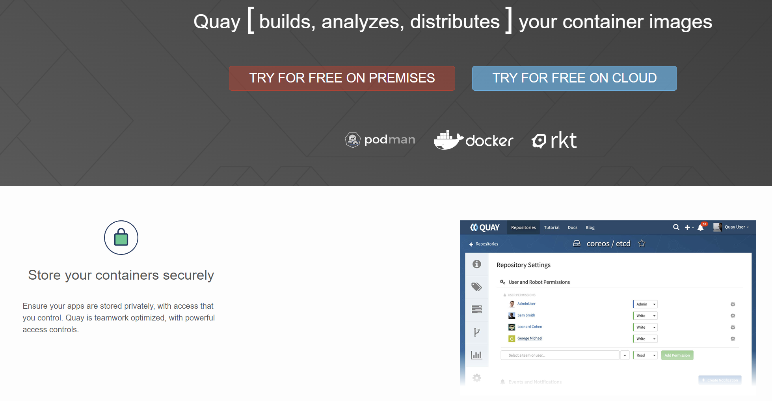
Demo: Quay.io
Notes:
https://quay.io/

Slide 23
Image name
jupyter/base-notebook start-notebook.py
Command
override

Slide 24
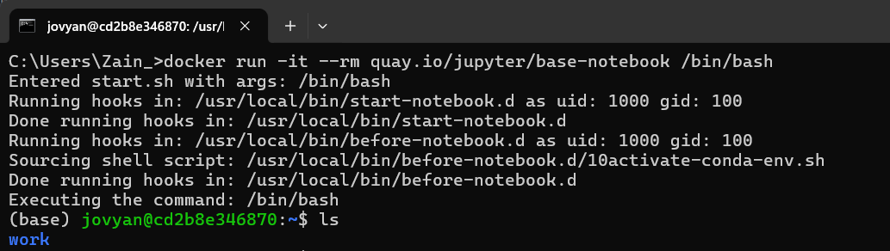
Demo: Start-notebook.py contents
Notes:
docker run -it --rm quay.io/jupyter/base-notebook /bin/bash
cd /usr/local/bin/
cat ./start-notebook.py

Slide 25
Command
override
start-notebook.py --NotebookApp.token='my-token'
Command arguments

Slide 26
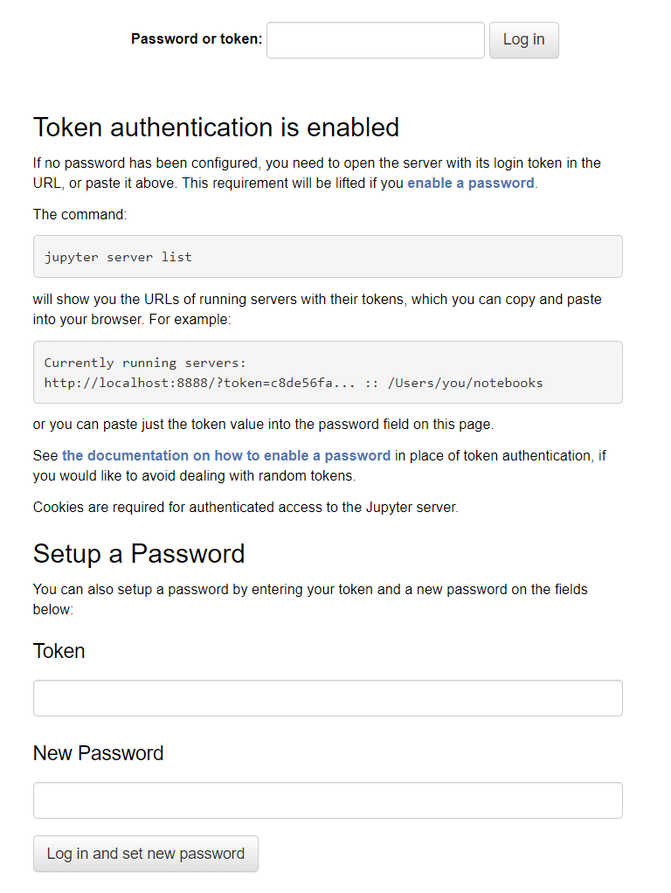
Demo: command arguments

Slide 27
Making changes

Slide 28
Command
override
start-notebook.py --NotebookApp.token='my-token'
Command arguments

Slide 29
Demo: getting rid of the token requirement
Notes:
docker run --rm -p 8889:8888 quay.io/jupyter/base-notebook start-notebook.py --NotebookApp.token=''

Slide 30
Remove the container
docker run --rm -p 8889:8888
Port assignment (Host:Container)

Slide 31
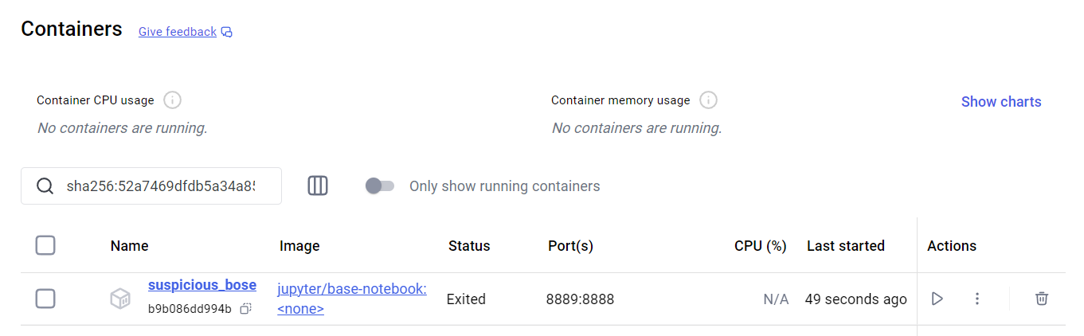
Demo: Persisting the container
Notes:
docker run -p 8889:8888 quay.io/jupyter/base-notebook start-notebook.py --NotebookApp.token=''

Slide 32
Port assignment
docker run -p 8889:8888 --name my_container
New container name

Slide 33
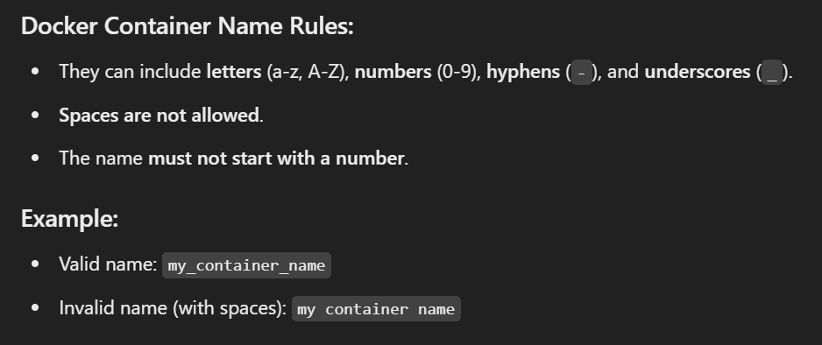

Slide 34
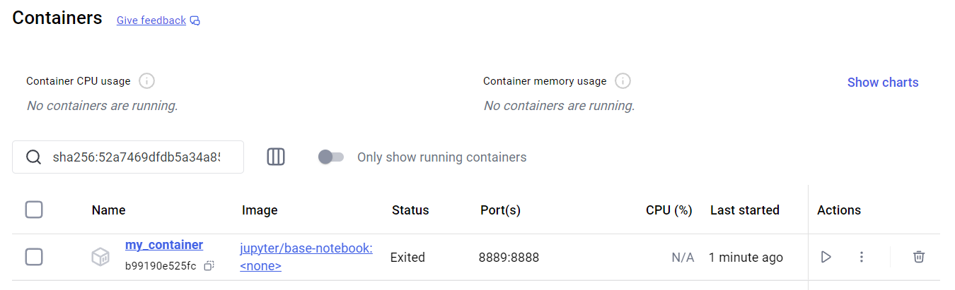
Demo: Naming your container
Notes:
docker run -p 8889:8888 --name my_container quay.io/jupyter/base-notebook start-notebook.py --NotebookApp.token=''

Slide 35
New container name
--name my_container
-v "C:/path/to/your/folder:/home/jovyan/work"
Disk mapping
(Host:Container)

Slide 36
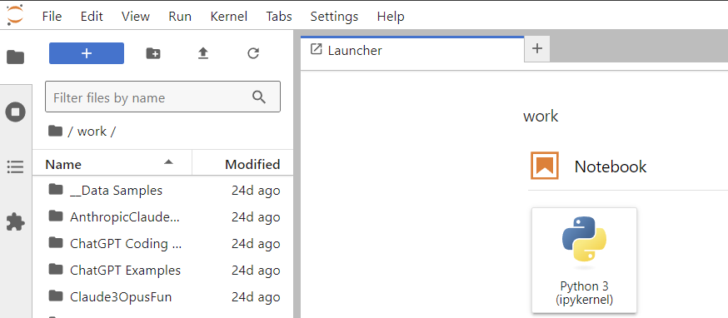
Demo: Mapping a volume
Notes:
docker run -p 8889:8888 --name my_container_with_disk -v "C:/Users/Zain_/Dropbox/Personal/Data Science Projects:/home/jovyan/work" quay.io/jupyter/base-notebook start-notebook.py --NotebookApp.token=''

Slide 37
